Slide 1
LEADERSHIP III FOR FIRE AND EMS: STRATEGIES FOR SUPERVISORY SUCCESS
COACHING

Slide 2
OBJECTIVES
The students will:
Identify characteristics of effective coaches.
Identify the similarities between effective coaches and effective leaders.
Identify four critical coaching techniques.
Match coaching techniques with subordinate performance.

Slide 3
OVERVIEW
The Leader as Coach
Vision
Self-Confidence and Humility
Confidence in Others
Flexibility

Slide 4
Activity C.1 Characteristics of Effective Coaches

Slide 5
The Leader as Coach
"Coaching is face-to-face leadership that pulls together people with diverse backgrounds, talents, experiences, and interests, encourages them to step up to responsibility and continued achievement, and treats them as full-scale partners and contributors." (From A Passion for Excellence.)

Slide 6
The Leader as Coach (cont'd)
Face-to-face leadership implies one-on-one interaction
Pulling together diverse people implies:
Accepting individual differences
Encouraging teamwork and cooperation

Slide 7
The Leader as Coach (cont'd)
Encouraging them to step up to responsibility and continued achievement implies:
Demanding the best from everyone
Holding people accountable
Rewarding accomplishments
Treating them as full-scale partners and contributors implies:
Mutual trust and respect
Willingness to listen
Willingness to compromise

Slide 8
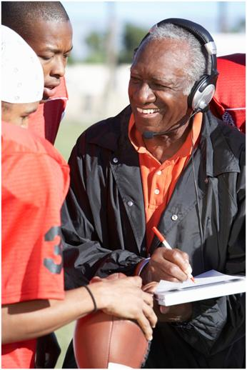
The Leader as Coach (cont'd)
Characteristics of an effective coach:
Vision
Self-confidence
Humility
Confidence in others
Flexibility

Slide 9
What does vision mean in the context of coaching?

Slide 10
Vision
Having a mental image of a possible and desirable future condition (Bennis).
Communicating that vision to others in such a way that they want to take part in working toward it.

Slide 11
How might a Company Officer (CO) demonstrate/communicate vision to subordinates?

Slide 12
Vision (cont'd)
A leader with vision:
Sees beyond the obvious
Visualizes the big picture
Has a future orientation

Slide 13
Vision (cont'd)
Seeing beyond the obvious
Recognizing each person's potential
Recognizing unique skills and abilities
Capitalizing on skills

Slide 14
What are some examples of offduty skills that could improve company effectiveness?

Slide 15
What "big-picture" concepts do COs need to recognize and communicate to subordinates?

Slide 16
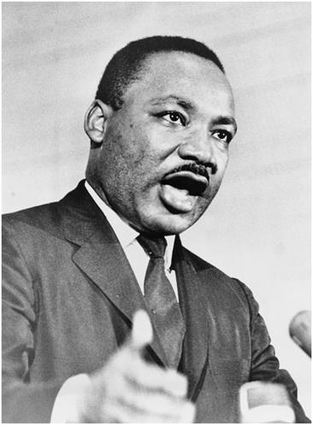
Vision (cont'd)
"I have a dream."
- Martin Luther King
"Some men see things as they are and ask 'why?' I dream things as they should be and ask 'why not?'" - Robert F. Kennedy

Slide 17
Vision (cont'd)
Tom Watson, founder of IBM, tells about a promising junior executive who was involved in a high-risk project and managed to lose over $10 million in the process. When Watson called the nervous executive into his office, the young man blurted out, "I guess you want my resignation." Watson's response was, "You can't be serious. We've just spent $10 million educating you!"

Slide 18
Vision (cont'd)
Future orientation
Treating individual or company failures as opportunities for learning.
-- Ineffective leaders react to failures with anger and direct their energy toward punishment.
-- Effective leaders react to failures with objectivity and direct their energy toward improvement.

Slide 19
Vision (cont'd)
Searching for ways to improve
Personally willing to try out new ideas
Receptive to ideas offered by subordinates.
Recognizing trends inside and outside the department

Slide 20
Activity C.2 Recognizing Trends

Slide 21
How does an effective coach balance self-confidence and humility?

Slide 22
Self-Confidence and Humility
Self confidence--self-esteem
Effective leaders recognize they have a position of authority due to their own proven ability, as evidenced by any of the following:
-- Past performance evaluations
-- Positive comments by peers or superiors
-- Successful performance during promotional procedures
-- Election to office by peer vote in a volunteer company

Slide 23
Self-Confidence and Humility (cont'd)
Self confidence--self-esteem
Rightly proud of their own success, and recognize their value to the organization
Don't let their egos get in the way
-- Aren't conceited
-- Able to poke fun at themselves

Slide 24
Self-Confidence and Humility (cont'd)
Self-confidence--making a difference
Effective leaders truly believe they can make a difference.
Accept the fact that they're responsible for the success or failure.
This allows them to focus on their leadership role instead of just being "one of the crew."

Slide 25
Self-Confidence and Humility (cont'd)
Technical expertise
Accept their own technical expertise and work hard to stay on top
Generous about sharing knowledge
Not threatened by subordinates who want to be as technically proficient as the leader

Slide 26
Self-Confidence and Humility (cont'd)
Humility
Effective leaders recognize dependence on work group.
Get things done through others:
-- You're not leading if no one is following.
-- You're not leading if you're doing everything yourself.
Leader gets evaluated on subordinates accomplishments!

Slide 27
Self-Confidence and Humility (cont'd)
Leadership priorities
Do whatever possible to help subordinates succeed.
Effective coaches accept responsibility for the success or failure of entire team or individuals.
Effective COs accept responsibility for the success or failure of the entire company or of each company individuals.

Slide 28
"I never criticize a player until he's convinced of my unconditional confidence in his ability." - Coach John Robinson, L.A. Rams

Slide 29
"Indiana basketball coach, Bobby Knight, rants and raves--and wins. San Francisco Forty-Niner coach, Bill Walsh, is so cool and collected he's known as 'The Professor' – and wins. Despite different styles, both exhibit compassion, empathy, and a belief in the ability of each team member."
- Tom Peters, A Passion for Excellence

Slide 30
Does a leader's opinion of subordinates have an impact on their performance?

Slide 31
Confidence in Others (cont'd)
You get what you expect
Expectations and treatment determines performance.
Superior leaders transmit high performance expectations that are fulfilled.
Subordinates do what they believe they are expected to do.

Slide 32
The Pygmalion Effect
Influence of one person's expectations on another person's performance
"Pygmalion" is the play that "My Fair Lady" is based on.
High expectations = high performance.
Low expectations = low performance.

Slide 33
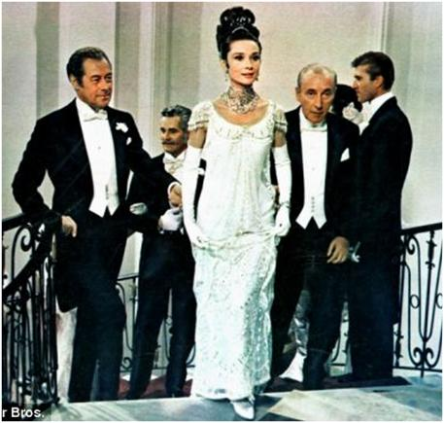
"You see … apart from the things one can pick up, the difference between a lady and a flower girl is not how she behaves, but how she is treated. "
THE PYGMALION EFFECT (cont'd)
- "My Fair Lady"

Slide 34
High
Expectations
High
Performance

Slide 35
Low
Expectations
Low
Performance

Slide 36
What are some examples of situations that illustrate the fact that people tend to do what's expected?

Slide 37
What are some examples of what coaches do to transmit high expectations to their players?

Slide 38
Confidence in Others (cont'd)
Personal feelings
Guard against tendency to like good performers and dislike poor performers
Difficult to hide how we feel
When we like someone, we:
Spend more time with them
Smile more in their presence
Find it easier to talk to them
Feel more comfortable with them
Find it easy to compliment them

Slide 39
Confidence in Others (cont'd)
When we dislike someone, we:
Spend as little time with that person as possible
Smile infrequently when around that person
Find it difficult to talk to that person
Feel uncomfortable when in that person's presence
Find it easy to criticize that person

Slide 40
Confidence in Others (cont'd)
Effective leaders focus on behaviors, not personalities.
Feeling dislike is a warning that you're communicating that as well and you need to start acting more positive.

Slide 41
Flexibility
Every player is important.
Individuals deserve attention.
Bad leaders focus attention on a few.
-- "If it's not broken don't fix it."
-- "If I ignore them, maybe they'll go away!"
-- "I'm not here to babysit; they're all adults and should be able to take care of themselves."

Slide 42
Flexibility (cont'd)
All of these approaches are counter-productive. Effective leaders are committed to doing whatever is necessary to get maximum performance from every individual.
Effective leaders understand what each individual needs for self-improvement.

Slide 43
Flexibility (cont'd)
Critical coaching techniques:
Training
Counseling
Challenging
Mentoring

Slide 44
Training
What is it?
Correcting unsatisfactory behavior, techniques, procedures, etc.
Maintaining proficiency in necessary skills
Providing feedback on performance
Bringing new employees up to speed
Preparing individuals and/or the whole group for new assignments, procedures, etc.

Slide 45
Training (cont'd)
How can it be done?
Postincident analysis
Drills
One-on-one skill building
"Buddy system"
Demonstration
Videotaping and critiquing
External training opportunities

Slide 46
Counseling
What is it?
Working with someone to help solve a problem
Getting the individual to recognize there's a problem
Helping the individual to identify the cause
Helping the individual to work out a solution
Helping individuals correct unsatisfactory work behavior not correctable by training
Monitoring progress

Slide 47
Counseling (cont'd)
How is it done?
Preparation
Private meeting with minimum advance notice
State your case and then listen
Discuss alternative solutions
Be supportive and patient, but insist on a plan of action
Follow up and encourage
Don't give up--counsel again, if necessary

Slide 48
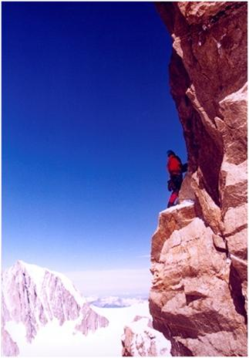
Challenging
What is it?
Helping individuals maximize their potential
Building on existing strengths
Setting attainable goals for improvement
Encouraging individuals to stretch to their capacity

Slide 49
What are some ways to challenge subordinates?

Slide 50
Challenging (cont'd)
How can you do it?
Assign additional tasks
Increase level of responsibility
Delegate an important project
Ask for help in training a poor performer, orienting a new crew member

Slide 51
Mentoring
What's involved?
Recognizing above-average potential
Fine-tuning skills
Providing opportunities to develop leadership skills
Providing opportunities for exposure
"Selling" the individual to upper-level
Regularly discussing individual's career goals

Slide 52
Mentoring (cont'd)
How can you do it?
Serving as a role-model
Personal tutoring prior to promotional exam
Recommending individual for special assignments
Special recommendations on performance appraisal forms
Delegating difficult and challenging projects which require leadership skill

Slide 53
Matching Technique to Performance
Know not only how to use techniques, but when
Following chart (also in Student Manual (SM)) provides analysis to match most effective technique to present performance of each subordinate

Slide 54
COACHING ANALYSIS MODEL #1
Describe
Present
Performance
Everything
Satisfactory?
Anything
Unsatisfactory?
Above
Satisfactory?
Describe
Performance
Discrepancy
Challenge
Mentor
Yes
Skill
Deficiency?
No
Train
Counsel

Slide 55
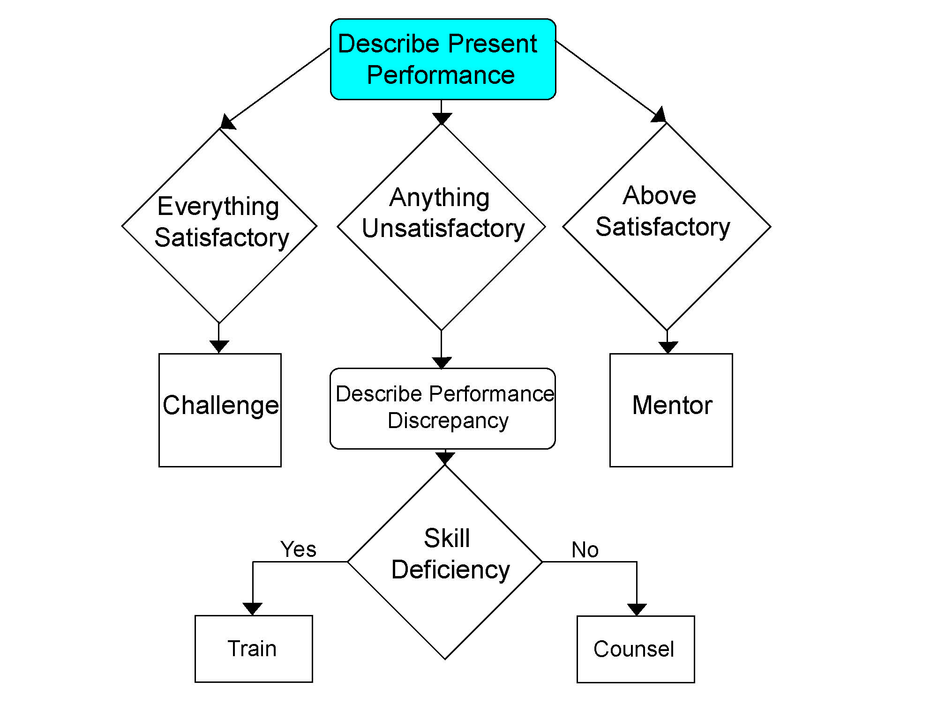
Matching Technique to Performance (cont'd)
How would you describe present performance?
Is all required performance satisfactory?
Skills/Techniques meet standards?
Work assignments complete?
Orders followed?
Policies and procedures?
Satisfactory employee meets standards but not much more than that.

Slide 56
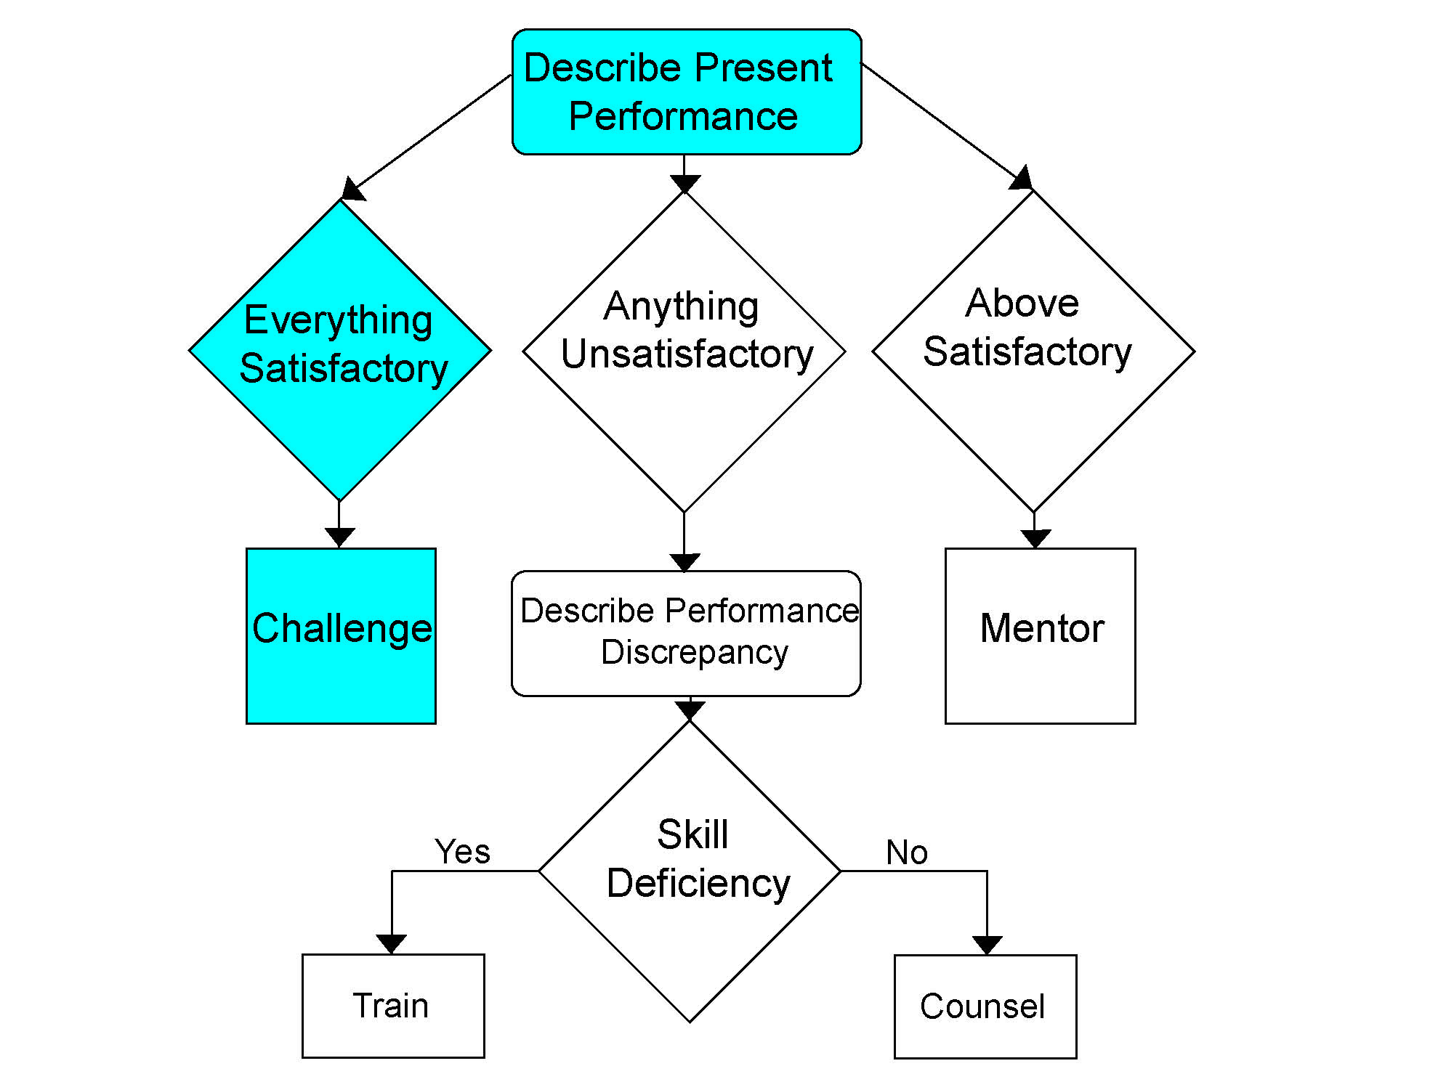
Matching Technique to Performance (cont'd)
If performance is generally satisfactory, leader needs to challenge individual.
Urge the individual to stretch.
Encourage the individual to contribute more to the overall effectiveness of the unit.

Slide 57
Matching Technique to Performance (cont'd)
Is required performance above satisfactory?
Do most skills/techniques exceed minimum standards?
Are work assignments generally completed with high quality and timeliness?
Are routine tasks completed without direct orders?
Does the individual frequently take the initiative?
An above-satisfactory employee consistently excels in most areas of the job.

Slide 58
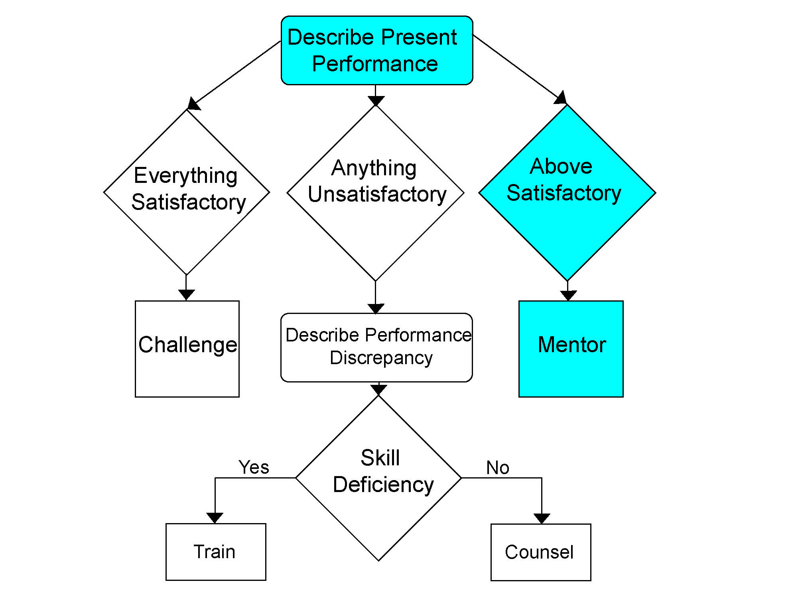
Matching Technique to Performance (cont'd)
If performance is above satisfactory, leader needs to be a mentor to individual.
Start preparing the individual for advancement.
Help the individual design a career development plan.
Provide opportunities to assume leadership roles.

Slide 59
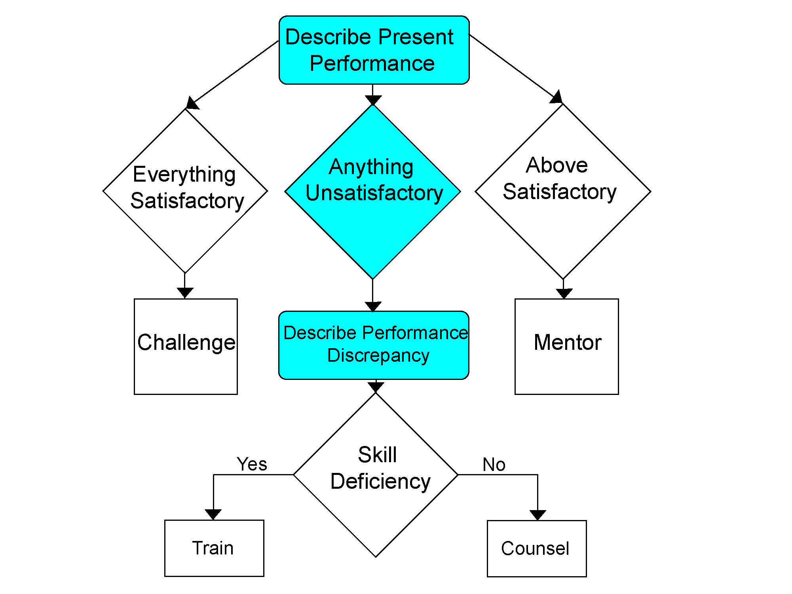
Matching Technique to Performance (cont'd)
Is any required performance unsatisfactory?
If yes, describe what's wrong in specific behavioral terms.
Determine whether problem is due to a skill deficiency or not.

Slide 60
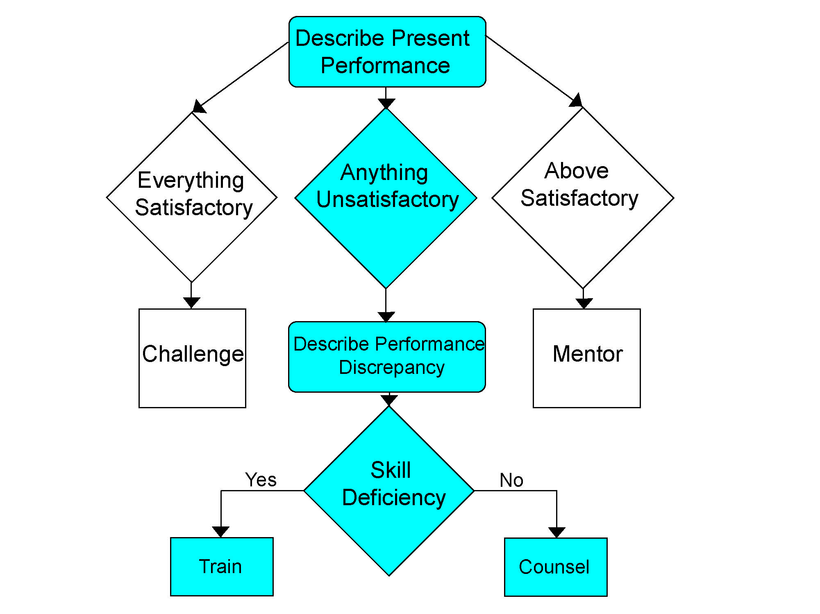
Matching Technique to Performance (cont'd)
Unsatisfactory performance due to a skill deficiency will need training.
Unsatisfactory performance not caused by skill deficiency will need counseling.
If cause is unclear, select training option.

Slide 61
Matching Technique to Performance (cont'd)
Analysis model is not something you do once a year.
Coaching is dynamic.
Continually monitor.
Use different techniques simultaneously.
Don't ignore performance problems, otherwise.
It will get worse.
You're liable.
You're subject to disciplinary action.
Subordinates think poor performance is OK.

Slide 62
COACHING ANALYSIS MODEL #2
T
R
A
I
N
I
N
G
C
O
U
N
S
E
L
I
N
G
Adapted from The Training and Development Sourcebook

Slide 63
T
R
A
I
N
I
N
G

Slide 64
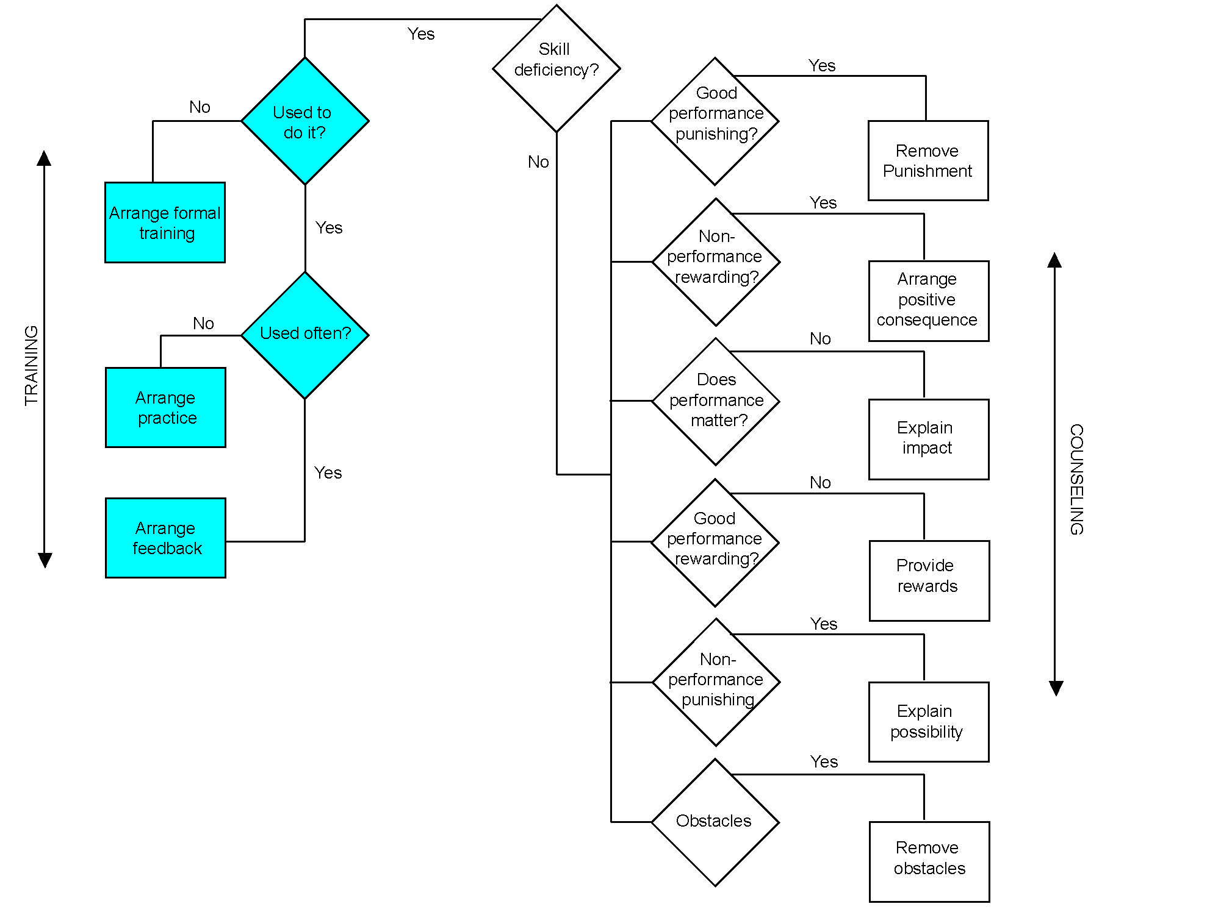
Matching Technique to Performance (cont'd)
Need to ask some questions:
Is it something the person used to know how to do but no longer does well?
If not, formal training.
It yes, move on.
Is the skill used very often?
If not, practices/drills.
If yes, provide feedback.

Slide 65
C
O
U
N
S
E
L
I
N
G

Slide 66
Matching Technique to Performance (cont'd)
Before counseling process, determine what is contributing to problem.
Answer all questions on model based on what you can observe.
Counseling style relies on face-to-face discussion.
In preparing, leader gathers as many facts as possible.
During counseling, subordinate adds additional information.

Slide 67
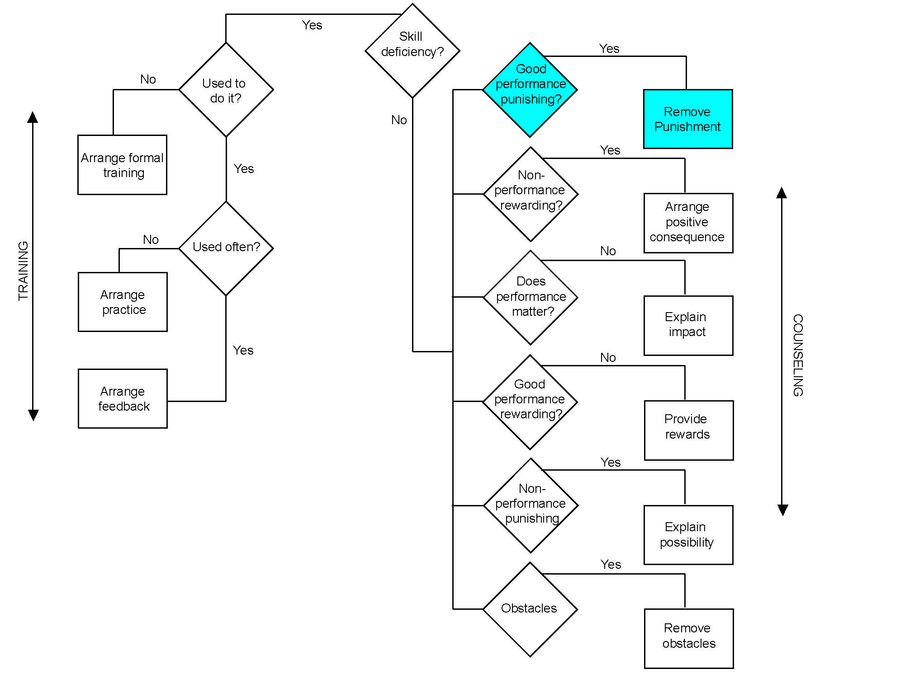
Matching Technique to Performance (cont'd)
Is good performance punishing?
If the subordinate performs well, does it lead to punishment?
Example: If the subordinate writes good reports is this assignment given more often?
If this is the case, we need to remove any punishments for good performance.

Slide 68
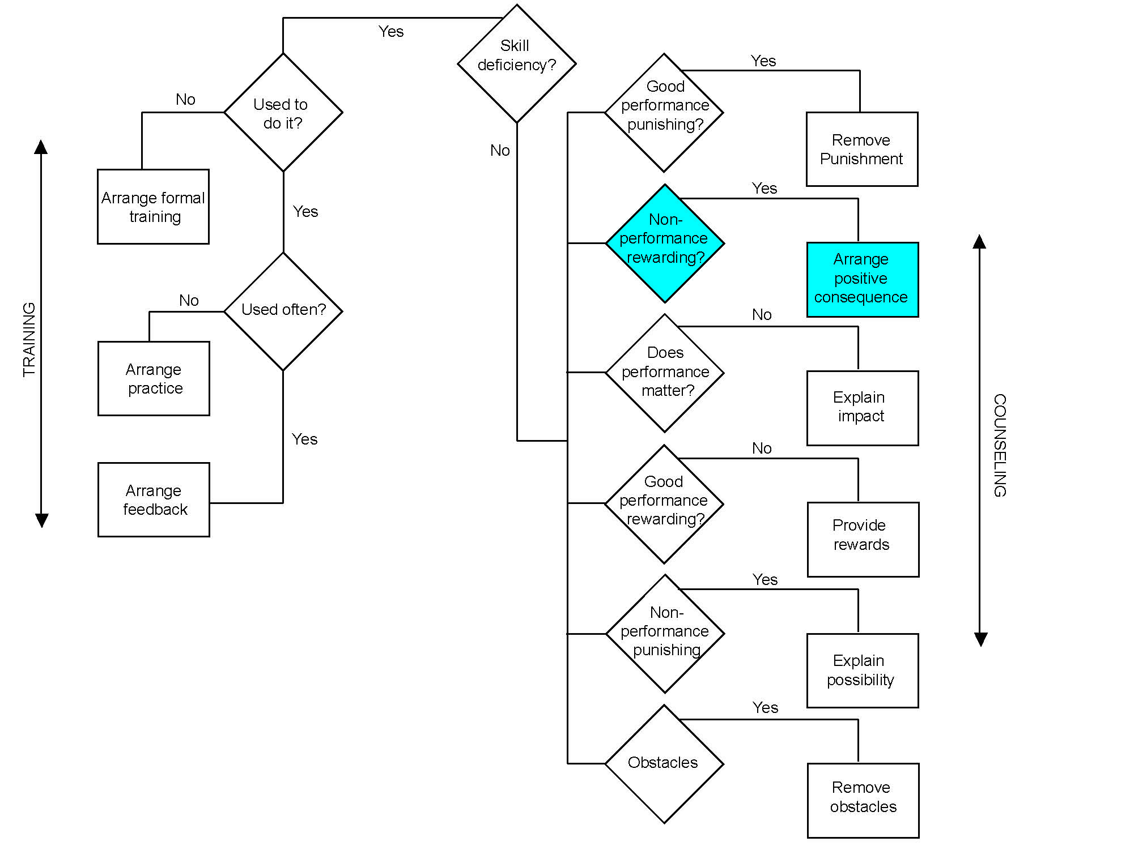
Matching Technique to Performance (cont'd)
Is nonperformance rewarding?
If the subordinate performs poorly, does it lead to a reward of some kind?
If this is the case, we need to remove any rewards for poor performance.

Slide 69
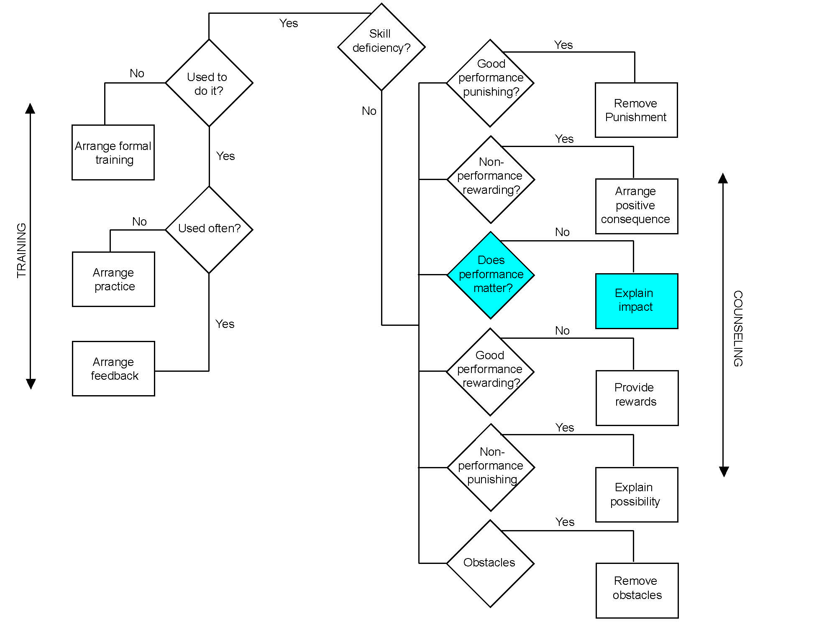
Matching Technique to Performance (cont'd)
Does performance matter?
Does the individual understand the impact of poor performance?
If this is the case, we need to carefully explain how the poor performance is hurting the quality of service, other team members, etc.

Slide 70
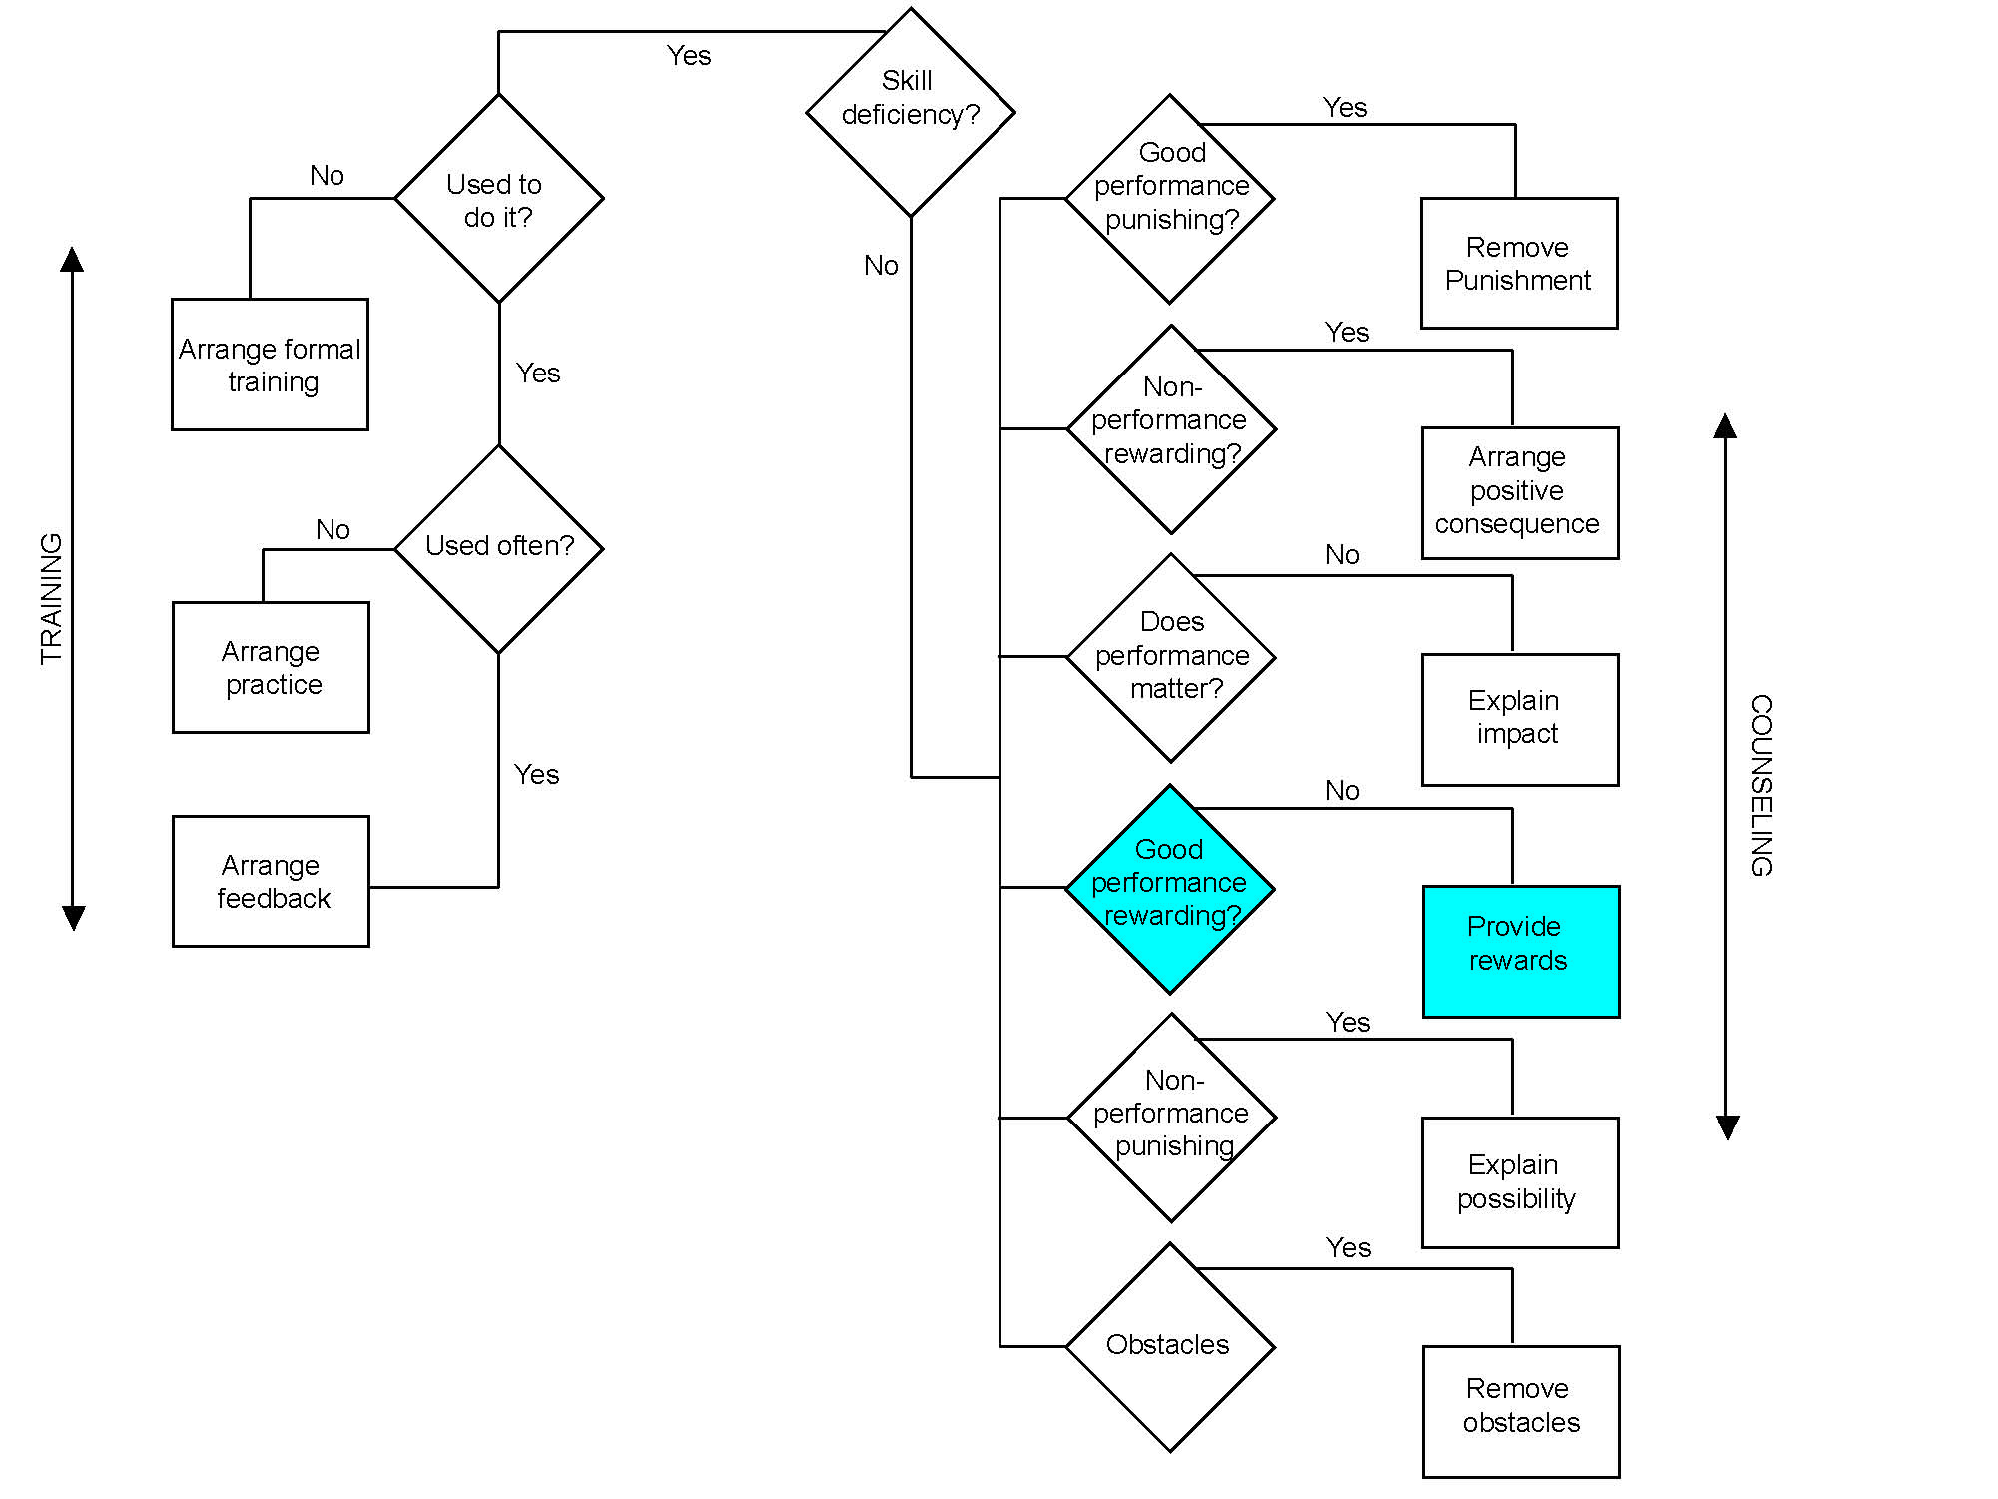
Matching Technique to Performance (cont'd)
Is good performance rewarded?
Does the individual see any reason to perform well? Is good performance rewarded?
If not, start providing meaningful recognition for good performance.

Slide 71
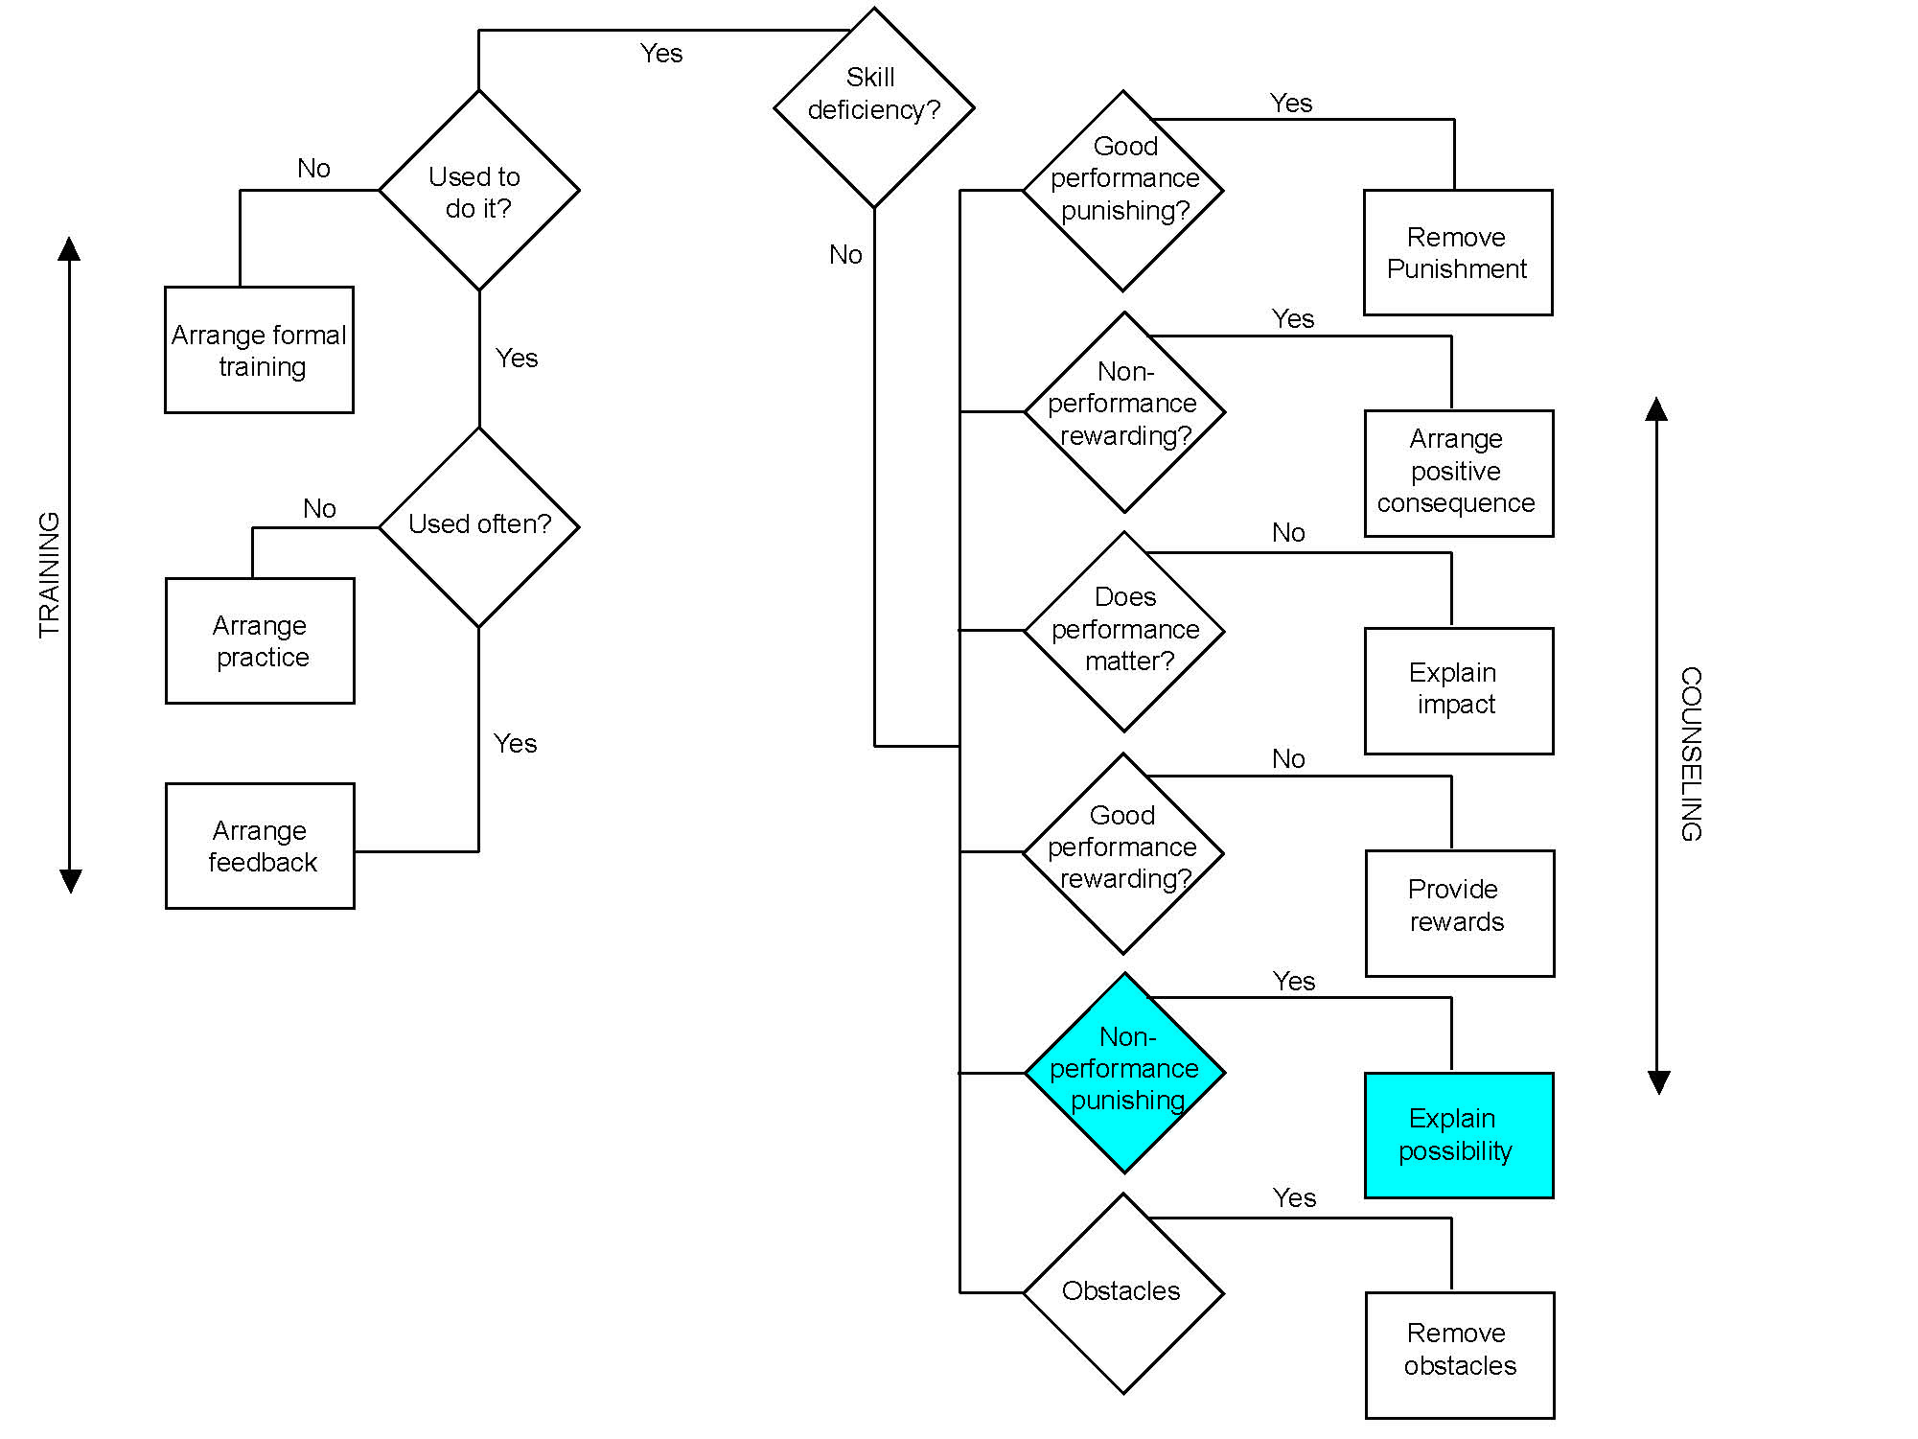
Matching Technique to Performance (cont'd)
Is nonperformance punished?
Does the individual see any reason to avoid poor performance? Are there any punishments in place for continued poor performance?
Make sure the individual understands refusing to allow you to help it will lead to formal discipline.

Slide 72
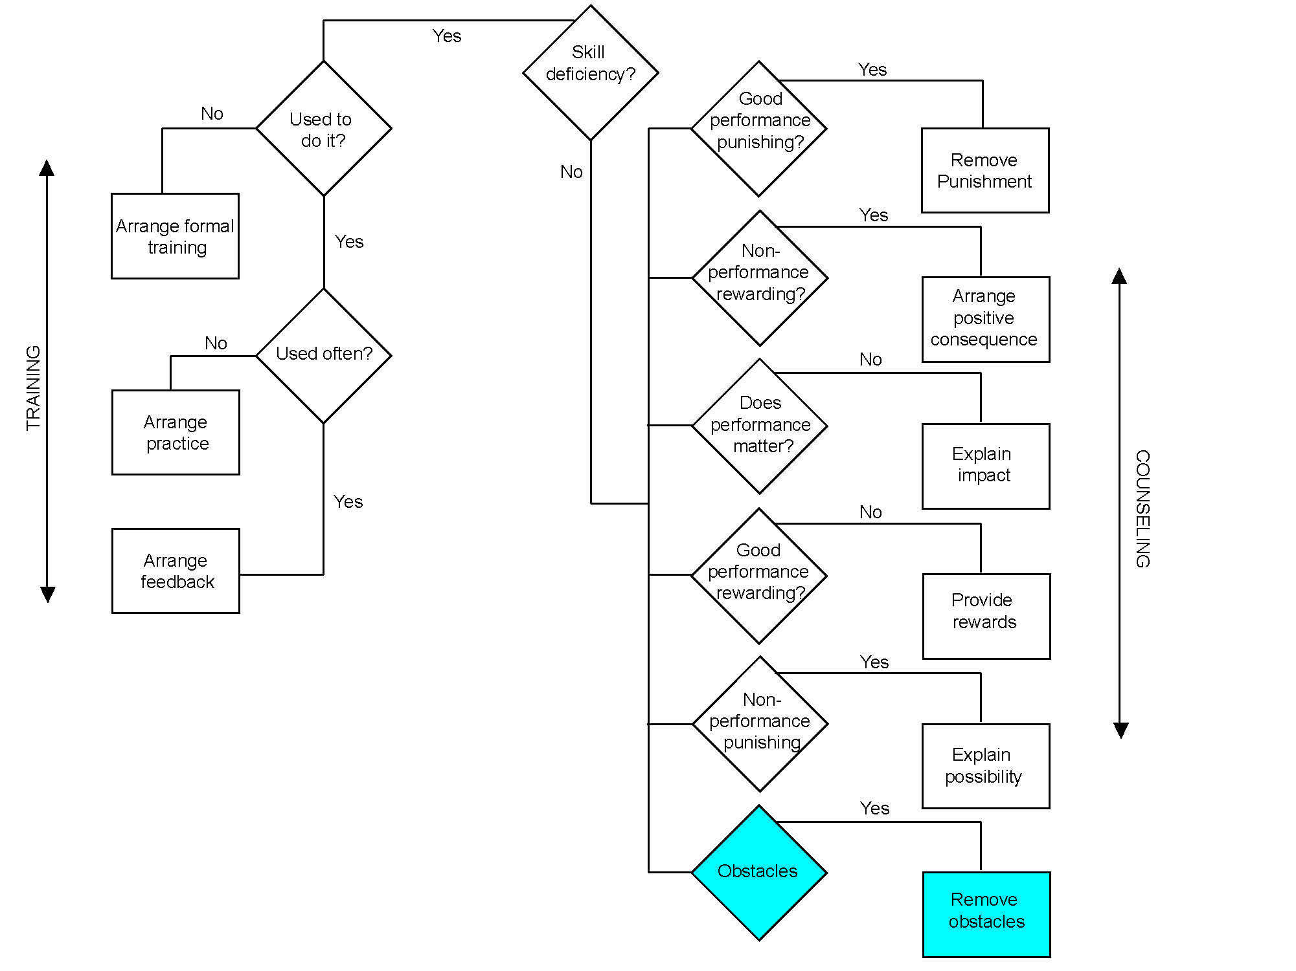
Matching Technique to Performance (cont'd)
Are there obstacles to performing?
Are there factors which prevent the individual from performing?

Slide 73
Activity C.3 Matching Coaching Techniques to Subordinate Performance

Slide 74
Summary
Effective leaders have many of the same characteristics as effective coaches:
Vision
Self-confidence
Humility
Confidence in others
Flexibility

Slide 75
summary (cont'd)
"Coaching involves praise and recognition (for each individual). But it also requires helping the individual/team withstand tough times and inevitable setbacks, maintaining momentum and building small successes into a solid track record."
(Peters and Austin)

